Slide 1
Recursive Language Models for Tool-Augmented Retrieval
Aryan Arora, Aadithya, Aarav, Aryan Jeena

Slide 2
Problem Statement/Motivation
LLMs struggle with long-context reasoning
As input length increases, attention diffuses across irrelevant tokens. Single-pass prompting fails on structured tasks like log parsing, multi-step retrieval, and aggregation
Technical Limitation
Irrelevant context wastes compute and increases hallucination risk, models lack iterative retrieval mechanisms
Core Challenge
Structured reasoning requires multi-step interaction with data, but standard LLM inference is a single forward pass with no external memory access.
Notes:
So the core problem we're tackling is that LLMs really struggle when you give them a lot of context to work with. The attention mechanism basically gets spread too thin across all these irrelevant tokens, and the model loses track of what actually matters.
And the technical issue is that all this extra context isn't just unhelpful it actually hurts. It wastes compute, makes the model more likely to hallucinate, and the biggest thing is that these models have no way to go back
and look at the data again.
So the core challenge is really this mismatch: tasks like log parsing or data
aggregation naturally require you to interact with the data in multiple steps
– but a standard LLM just reads everything once and gives you an answer. There's no external
memory, no ability to run code against the data. And that's exactly what our
project tries to fix - we give the model a Python REPL so it can actually
write code to interact with the data iteratively, instead of trying to do
everything in its head in one pass.

Slide 3
Technical Approach
External Memory
Tool-Based Interaction
MDP Formulation
The long context is stored outside the model in a Python environment.
The model does not need to attend to every token at once.
The agent generates Python code to query the context, the code runs in a sandboxed REPL, and the result is returned for the next step.
Tool use is modeled as a Markov Decision Process, the agent chooses either code or a final answer, and the reward balances correctness, steps, and token usage.
Notes:
Our core idea is to avoid forcing the model to attend to the entire long context at once.
First, we store the long context externally in a Python environment. This means the model does not need to process thousands of tokens in a single forward pass.
Second, instead of directly generating the final answer, the model generates Python code. That code runs in a sandboxed REPL, and the output becomes part of the next state. This enables multi-step reasoning.
Finally, we formalize this interaction as a Markov Decision Process. At each step, the agent chooses either to generate code or to return a final answer.
The reward encourages correctness, but also penalizes unnecessary steps and excessive token usage. So the model learns to be both accurate and efficient.

Slide 4
System Architecture
(3 Components)
1
2
A task generator produces synthetic (context, question, answer) tuples.
The agent writes Python code to query the context.
3
The long context lives in a Python variable, not in the prompt. The agent interacts with it through tool calls.
A sandboxed REPL executes the code and returns output.
Notes:
So our system has three main pieces that work together. First, the task generator. This creates the problems for our model to solve – three things, a context, then a question
about that context, and the ground-truth answer so we can check if the model got it right.
Second, the agent. This is the LLM. But here's the key thing - we don't just dump the entire context into the prompt and say 'answer this.' Instead, the
long context gets stored in a Python variable called CONTEXT, and the agent writes Python code to search through it.
Third, the sandboxed REPL. This is where the agent's code actually runs. It's a safe execution environment - we whitelist only certain Python builtins,
The REPL runs the code and sends the output back to the agent. If there's an error, the agent sees the traceback and can try again with fixed code.
So the flow is: task generator creates the problem, the agent writes code to solve it, the REPL executes that code safely and returns the result. And the
important distinction is that the long context lives in a Python variable, not in the model's prompt.
The fundamental insight is the same as with Claude COde: instead of cramming everything into one giant prompt and hoping the model figures it out, you give the model tools and
let it interact with the data step by step.

Slide 5
Task Types
We evaluate the system on three structured task families.
Needle-in-Haystack requires finding a hidden piece of information
KV Extraction requires filtering structured logs and extracting a key-value pair.
Aggregation requires finding multiple metrics and summing their values.
All tasks are synthetically generated with known ground-truth answers.
Notes:
We evaluate the system on three structured task families that increase in reasoning difficulty.
The first is Needle-in-Haystack. The model must retrieve a hidden key-value pair from a long context. This tests basic tool use.
The second is KV Extraction. Here, the model must filter structured log entries and extract a specific field. This requires chaining at least two reasoning steps.
The third is Aggregation. The model must find multiple values and compute their sum. This requires maintaining intermediate state and performing computation over several tool calls.
All tasks are synthetically generated, which means we always know the ground-truth answer. That allows us to compute reward automatically and scale training.

Slide 6
Training Pipeline
Training occurs in two phases.
We perform Behavior Cloning using 500 expert trajectories generated by the heuristic agent.
We fine-tune Qwen2.5-Coder-1.5B with LoRA adapters for three epochs.
We apply REINFORCE.
The model generates code, the sandbox executes it, and reward is computed.
Policy gradients update the model toward higher-reward trajectories.
Notes:
Training occurs in two phases.
In the first phase, we perform Behavior Cloning. We generate 500 expert trajectories using a heuristic agent that solves tasks perfectly. We then fine-tune a Qwen 1.5B coder model using LoRA adapters for three epochs. This teaches the model basic tool-use behavior through supervised learning.
In the second phase, we apply REINFORCE. Now the model generates code independently. The sandbox executes the code, and we compute reward based on correctness, number of steps, and token usage.
We then update the policy using policy gradients to maximize expected reward.
Behavior Cloning provides a strong initialization, and reinforcement learning improves efficiency and multi-step reasoning.

Slide 7
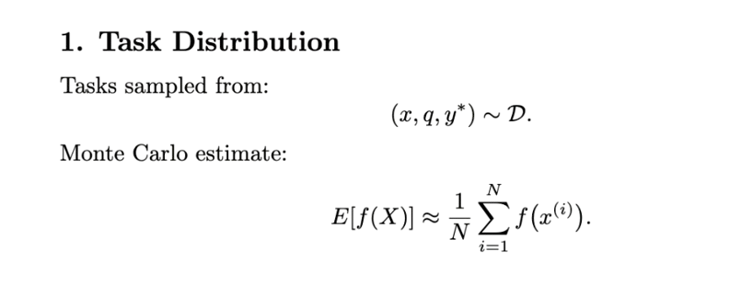

Slide 8
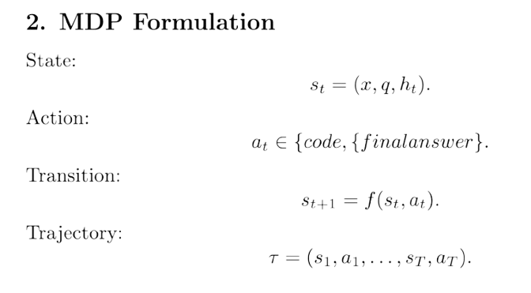

Slide 9
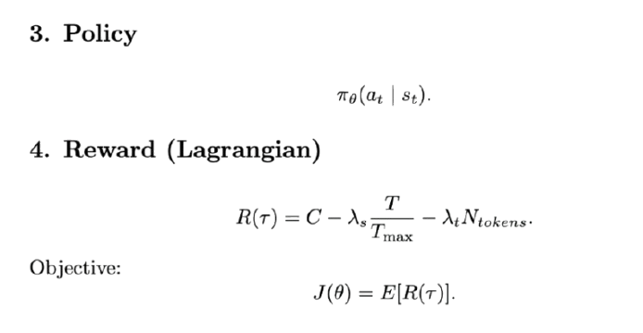

Slide 10
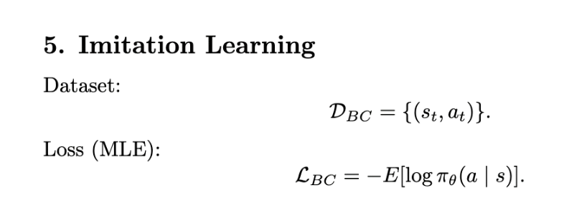

Slide 11
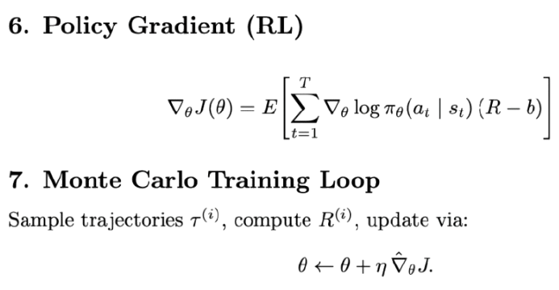

Slide 12
Initial Results and Analysis
The trained local LLM (Qwen 1.5B, Behavior Cloning + RL) achieves:
Needle-in-Haystack: 100% accuracy.
KV Extraction: 90% accuracy.
Aggregation: 50% accuracy.
The heuristic baseline achieves 100% across all tasks.
As expected, the LLM performs better in single to low step tasks.
Notes:
So here's what we got after training our model. We took Qwen 1.5B - which is a pretty small language model - trained it first with behavior cloning on examples from our hand-coded agent, then refined it with REINFORCE. And the results break down by task difficulty.
As you can see, the needle in haystack task went well – which is expected as it is just aiming to find one thing in a big block of text. The model learned how to write a regex search.
For Key-value pair extraction, the model mostly gets it right but sometimes the code doesn’t filter properly.
Aggregation is where it drops to 50%. This is the hardest task - the model has to find multiple keys scattered throughout the text, extract all their values, and sum them up. That's multiple steps of reasoning and the model only gets it half the time
Our python strategies achieved 100% across all tasks.
The model does great on simple tool use - write one search, get the answer. It does okay when there's a structured two-step process. But when it needs to chain together multiple operations and keep track of intermediate results, it struggles. So the model can learn to use tools, but deeper multi-step reasoning is still hard for a 1.5 billion parameter model. That's really what we want to improve in the next phase of the project

Slide 13
Limitations
Aggregation accuracy (50%) needs improvement
Model struggles with multi-step reasoning: find multiple keys → sum values → return result
Small model (1.5B) limits code generation quality
Chosen for training speed and compute cost, but reduces capability vs larger models
Only 3 synthetic task types, no real-world data
Only trained for ~ 30 epochs
Notes:
The biggest issue we're facing is that aggregation
task accuracy is only at 50%. Needle-in-haystack and KV extraction are
both at very high accuracy, but when the model needs to find multiple keys
and sum them up, it struggles. We need to understand why—whether it's a
prompt engineering issue, a training data issue, or just inherent
difficulty for the 1.5 billion parameter model we're using.
Speaking of the model size, that's our second limitation. 1.5B parameters
is quite small compared to modern LLMs, and it does limit code generation
quality. We chose it for practical reasons—training speed and compute
costs—but we acknowledge it's a constraint.
Third, we're only testing on three synthetic task types right now.
Everything is generated programmatically—random haystack text, created log
entries, synthetic metrics. We haven't validated on real-world data yet,
which is a big gap.
And finally, we’ve only trained for about 30 epochs so far. That means the model is probably under-trained for the harder behaviors such as aggregation.

Slide 14
Next Steps
Reward-weighted policy gradient (PPO)
Implement clipped objective for more stable policy updates and faster convergence
New tasks: multi-condition filtering, code search
Compare trained model vs long-context baseline
Benchmark against GPT/Gemini/Claude with full context; measure accuracy, token usage, and cost efficiency
Train longer + measure saturation (30 → 100+ epochs, staged)
Notes:
Our first priority is to move from REINFORCE to Proximal Policy
Optimization. PPO is a more stable policy gradient algorithm that clips
the updates to prevent the policy from changing too dramatically in one
step. This should help with the training instability we mentioned.
Second, we're going to expand our task types. Right now it's just
needle-in-haystack, KV extraction, and aggregation. We want to add
multi-condition filtering and code search tasks, where
the model has to navigate through a codebase to find a specific function
or class.
We also need to run a rigorous comparison against a long-context
baseline. We'll take the same tasks and feed the entire context into a
large model like GPT-4 or Claude, and measure whether our tool-augmented
approach with the small model actually outperforms just dumping everything
into a huge context window.
Lastly, we want to extend training in a staged way—for example 30 → 60 → 100+ epochs, tracking checkpoints, looking for a learning curve.

